Slide 1
Sampling and Sampling Distributions

Slide 2
Introduction
Population: means collection of all items or units under study. Population need not necessarily means only the count of human beings under study. The term population is used to refer any collection of living or non living things.
Parameter: The characteristics of the population under study are called parameter of the population.
These characteristics are of population are generally mean, median, mode, total, standard deviation, coefficient of variation are the parameter of populatio.

Slide 3
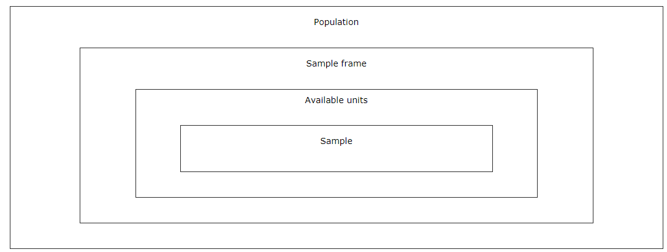
A population is the total group of individual about who you are researching and about which you want to draw conclusions.
Census: When all units of population are examined then such an inquiry is known as complete enumeration or census.
In practical situation, it is not feasible to undertake census both financially or time wise since complete enumeration
Sample frame: The list of individual from whom you draw your sample, such as a phone book or 'people shopping in town today', may well be less than the entire population and is called a sample frame. Sample frames are usually much larger than the sample. They are used because of convenience and the difficulty of accessing people outside this frame (for example those without a telephone).

Slide 4
Sample: When the population is large or generally inaccessible (such as the population of Birmingham) then the approach used is to measure a subset or sample.
Sample intensity: refers to the proportion of the population that is been sampled.
Sample size refers to the number n of sampling units that are selected from the population.

Slide 5
Sample shape : A shape is a figure or surface area enclosed by a boundary of sample. For example; circle, triangle, rectangle etc.

Slide 6
Types of sampling
There are basically 2 methods of sampling. They are random and nonrandom sampling.
Four main types of sampling methods are:
Simple random sampling, systematic sampling, stratified sampling, cluster sampling, multistage sampling

Slide 7
Simple random sampling: A simple random sampling is a method of sampling in which each and every unit of population has an equal chance of being selected. This sampling cn be drawn in 2 ways: with replacement and without replacement.
With replacement: You replace the item each time you choose one from the sample unit.
Without replacement: If sample unit drawn once is not replaced back before next draw is known as without replacement

Slide 8
Selection procedure
Lottery method: is number of chits of paper (homogenous size) equal to the size of the population
Method using random number: it is numbered the population digitally and draw randomly

Slide 9
Stratified Sampling
Units of the population are derived into relatively homogenous groups called strata. For example, geographical regions of Nepal can be stratified into mounts, hill and Terai. Income of the people, level of pollution like low, average and high

Slide 10
Systematic random sampling
In systematic sampling, a unit randomly and rest of units selected at equal interval. Therefore, systematic sample is generated with only one draw.
Drawing systematic sampling is convenient than drawing a simple random sample since it can be formed in only one random. Systematic sampling is widely used in surveys. A systematic sample divides units into n strata and the units are evenly spaced.

Slide 11
Cluster sampling
Let the population under study be divided into n clusters of unit. Instead of selecting units from the population randomly clusters of units are selected randomly and every unit of the selected cluster is enumerated.
Such a sampling procedure is called cluster sampling. For example, population of households of certain area can be divided into blocks or cluster of households. Cluster sampling is more effective than simple random sampling only if units within clusters are not heterogeneous.

Slide 12
Multistage sampling
In multistage sampling, the process can be generally extended more than two stages of selections.

Slide 13
How to find the number of sample plot
Sample size refers to the number n of sampling units that are selected from the population. Sampling intensity refers to the proportion of the population that is been sampled. It is important to realize that the standard error depends on sample size and not on sampling intensity.
Sample intensity=(Total Sample area/Total area)*100
Sample Intensity= (N*Individual Sample plot area/Total area)*100
N= (Total Sample area/Total area* Sample Intensity)*100
Find the number of sample plot, if sample size is 20*25, SI is 1% and total forest area is 120 ha?

Slide 14
Coefficient of variation (CV) is a normalized measure of dispersion of a probability distribution or frequency distribution
n=(C V* t /E)²; Where,
n equals to number of sample plot required
CV= Coefficient of variation of basal area
CV= S*100/ (X mean)
t=value of obtained from the student’s t-distribution Table at n-1 degree of freedom of pilot study at 10% probability
E= sampling error at 10% probability
At least 15 sample plots are taken as a pre-sample

Slide 15
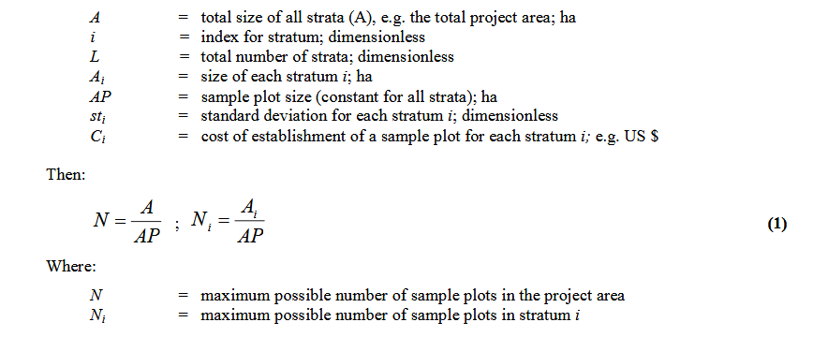
Initial calculation (based on CDM)
It is assumed that the following parameters are known from the project set up, pre-project estimates (e.g. results from a pilot-study ) or literature data:

Slide 16
Strata of Polluted area | Area ha | No of sample plot
A | 50
B | 30
C | 30
D | 40
E | 20
Total number of sample plot | 170
Distribute the sample plots

Slide 17
Strata of Polluted area | Area ha | No of sample plot
A | 50
B | 30
C | 30
D | 40
E | 20
Distribute the sample plots
Let sample intensity is 1%
Find the number of sample, plot size is 20m*25m

Slide 18
Based on the species richness
The maxim number of species and shows the stable number of plots.

Slide 19
Based on co-efficient variance ( Food Agriculture Organization)
n=(z*CV/AE)²
n is the number of sample plots required, Z is generally 4 at 95% confidence level, CV is coefficient variance and AE allowable error, it is generally 10%.
CV is calculated based on the pilot sampling, estimation based on the basal area in forest sampling.

Slide 20
Calculation of sample size for continuous data
A. For infinite population:-
t²× (Sy)² (1.96)² × (.5) ²
n = = = 385,
E² (.05) ²
where,
n = Sample size required
t = t value (1.96) at 95 % confidence level.
Sy = Standard deviation of the population = (50%).
E = Precision level = ±5% = 0.05
Similarly, the sample size for finite population can be calculated by using the following formula:-

Slide 21
B. For finite population,
N×t² × (Sy ) ² 1000× (1.96)² × (.5² )
n = =
N× E² + t² (Sy)² 1000 × (.05 )² + (1.96)² × (.5) ²
960.4
n =
2.5 + 0.9604
960.4
n = = 278
3.4604
Where N =1000
n = Sample size required
E = (Precision level) = ±5% = 0.05
Sy = Standard deviation of the population = (50%).
t = t value (1.96) at 95 % confidence level.

Slide 22
Calculation of sample size for discrete data
A. For infinite population (if f.p.c. is ignored):-
t² ×p×q (1.96)²× (.4) × (0.6)
n = =
E² (.05)²
0.921984
= = 368.79 = 369 individual
.0025
where n = Sample size required
t = t value at 95% confidence limit
E = (Precision level) = ±5% = 0.05
p = 0.4 and q = 1-p = 1-0.4 = 0.6
p = Number having the specified attribute 40
= = 0.4
Number Observed 100
Number not having the specified attribute
q =
Number Observed
Calculation of sample size for discrete data

Slide 23
Using Published Tables
Table present sample sizes that would be necessary for given combinations of precision, confidence levels, and variability.
It should be noted that these sample sizes reflect the number of obtained responses, and not necessarily the number of surveys mailed or interviews planned (this number is often increased to compensate for non response).
Second, the sample sizes in Table presume that the attributes being measured are distributed normally or nearly so.

Slide 24
Table Sample size for ±3%, ±5%, ±7% and ±10% Precision Levels Where Confidence Level is 95% and P=0.5
Size of | Sample Size (n) for Precision (e) of:
Population | ±3% | ±5% | ±7% | ±10%
500 | a | 222 | 145 | 83
600 | a | 240 | 152 | 86
700 | a | 255 | 158 | 88
800 | a | 267 | 163 | 89
900 | a | 277 | 166 | 90
1,000 | a | 286 | 169 | 91
2,000 | 714 | 333 | 185 | 95
3,000 | 811 | 353 | 191 | 97
4,000 | 870 | 364 | 194 | 98
5,000 | 909 | 370 | 196 | 98
6,000 | 938 | 375 | 197 | 98
7,000 | 959 | 378 | 198 | 99
8,000 | 976 | 381 | 199 | 99
9,000 | 989 | 383 | 200 | 99
10,000 | 1,000 | 385 | 200 | 99
15,000 | 1,034 | 390 | 201 | 99
20,000 | 1,053 | 392 | 204 | 100
25,000 | 1,064 | 394 | 204 | 100
50,000 | 1,087 | 397 | 204 | 100
100,000 | 1,099 | 398 | 204 | 100
>100,000 | 1,111 | 400 | 204 | 100
Note: if the normal assumption of population is poor then the entire population should be sampled (Yamane, 1967).

Slide 25
Table Sample size for ±5%, ±7% and ±10% Precision Levels Where Confidence Level is 95% and P=0.5
Size of | Sample Size (n) for Precision (e) of:
Population | ±5% | ±7% | ±10%
100 | 81 | 67 | 51
125 | 96 | 78 | 56
150 | 110 | 86 | 61
175 | 122 | 94 | 64
200 | 134 | 101 | 67
225 | 144 | 107 | 70
250 | 154 | 112 | 72
275 | 163 | 117 | 74
300 | 172 | 121 | 76
325 | 180 | 125 | 77
350 | 187 | 129 | 78
375 | 194 | 132 | 80
400 | 201 | 135 | 81
425 | 207 | 138 | 82
450 | 212 | 140 | 82

Slide 26
THANKS TOO MUCH

